Slide 1

DIVINE GRACE COLLEGE OF ARTS, SCIENCE AND TECHNOLOGY
(DGCAST) — GAROUA | GEOGRAPHY DEPARTMENT
UPPER SIXTH ARTS — ENVIRONMENT AND DEVELOPMENT — LESSON 6
Flooding
Mr KAMDEM EMMANUEL
Geography Teacher — PLEG
Academic Year 2026 / 2027
Notes:
Good morning, class. Today we study Lesson 6: Flooding.

Slide 2
GEOGRAPHY — UPPER SIXTH ARTS
CLASS INFO
Class, Chapter & Duration
Class | Upper Sixth Arts
Chapter | Module 7: Understanding and managing contemporary environmental and development issues
Duration | 2 periods (2 × 50 minutes)
2026 / 2027
DGCAST GAROUA — GEOGRAPHY DEPARTMENT
Mr KAMDEM E. | 2

Slide 3
GEOGRAPHY — UPPER SIXTH ARTS
IDENTIFICATION
Lesson Identification
Topic | Contemporary Environmental Issues
Sub-topic | Climate Change
Lesson | Lesson 6: Flooding
Notions / Concepts | Flood, floodplain, storm hydrograph, lag time, hard engineering, soft engineering.
Syllabus focus | Meaning and magnitude; physical and human causes; effects; adaptation and mitigation measures.
Competence | Learners are able to explain the causes and effects of floods and propose measures.
2026 / 2027
DGCAST GAROUA — GEOGRAPHY DEPARTMENT
Mr KAMDEM E. | 3

Slide 4
GEOGRAPHY — UPPER SIXTH ARTS
OBJECTIVES
Learning Objectives
By the end of the lesson, the learner should be able to:
Define flooding and describe its magnitude.
Explain the causes and effects of floods.
Propose measures to reduce flood damage.
2026 / 2027
DGCAST GAROUA — GEOGRAPHY DEPARTMENT
Mr KAMDEM E. | 4

Slide 5
GEOGRAPHY — UPPER SIXTH ARTS
RECALL
Recall
Rivers overflow in the rainy season.
Concrete does not absorb water.
2026 / 2027
DGCAST GAROUA — GEOGRAPHY DEPARTMENT
Mr KAMDEM E. | 5

Slide 6
GEOGRAPHY — UPPER SIXTH ARTS
REAL-LIFE SITUATION
Real-Life Situation
Every rainy season, parts of Douala and Maroua are flooded. Houses built near rivers are destroyed, drains are blocked with rubbish and cholera spreads.
2026 / 2027
DGCAST GAROUA — GEOGRAPHY DEPARTMENT
Mr KAMDEM E. | 6
Notes:
Read the situation slowly, twice.

Slide 7
GEOGRAPHY — UPPER SIXTH ARTS
REAL-LIFE SITUATION
Situation — Question 1
What is the problem in the situation?
2026 / 2027
DGCAST GAROUA — GEOGRAPHY DEPARTMENT
Mr KAMDEM E. | 7

Slide 8
GEOGRAPHY — UPPER SIXTH ARTS
REAL-LIFE SITUATION
Answer
Floods destroy houses and spread disease.
2026 / 2027
DGCAST GAROUA — GEOGRAPHY DEPARTMENT
Mr KAMDEM E. | 8

Slide 9
GEOGRAPHY — UPPER SIXTH ARTS
REAL-LIFE SITUATION
Situation — Question 2
Give one human cause in the situation.
2026 / 2027
DGCAST GAROUA — GEOGRAPHY DEPARTMENT
Mr KAMDEM E. | 9

Slide 10
GEOGRAPHY — UPPER SIXTH ARTS
REAL-LIFE SITUATION
Answer
Blocked drains (or building near rivers).
2026 / 2027
DGCAST GAROUA — GEOGRAPHY DEPARTMENT
Mr KAMDEM E. | 10

Slide 11
GEOGRAPHY — UPPER SIXTH ARTS
REAL-LIFE SITUATION
Situation — Question 3
Give one effect.
2026 / 2027
DGCAST GAROUA — GEOGRAPHY DEPARTMENT
Mr KAMDEM E. | 11

Slide 12
GEOGRAPHY — UPPER SIXTH ARTS
REAL-LIFE SITUATION
Possible Answer
Cholera (or destroyed houses).
2026 / 2027
DGCAST GAROUA — GEOGRAPHY DEPARTMENT
Mr KAMDEM E. | 12

Slide 13
GEOGRAPHY — UPPER SIXTH ARTS
JUSTIFICATION
Justification of the Lesson
This lesson helps us to prevent and reduce flood damage.
2026 / 2027
DGCAST GAROUA — GEOGRAPHY DEPARTMENT
Mr KAMDEM E. | 13

Slide 14

GEOGRAPHY — UPPER SIXTH ARTS
I. MEANING
Activity 1
A flooded village.
2026 / 2027
DGCAST GAROUA — GEOGRAPHY DEPARTMENT
Mr KAMDEM E. | 14
Notes:
Without the projector: describe a flood you saw.

Slide 15
GEOGRAPHY — UPPER SIXTH ARTS
I. MEANING
Activity 1: Question
What is a flood?
2026 / 2027
DGCAST GAROUA — GEOGRAPHY DEPARTMENT
Mr KAMDEM E. | 15

Slide 16
GEOGRAPHY — UPPER SIXTH ARTS
I. MEANING
Answer
When water covers land that is normally dry.
2026 / 2027
DGCAST GAROUA — GEOGRAPHY DEPARTMENT
Mr KAMDEM E. | 16

Slide 17
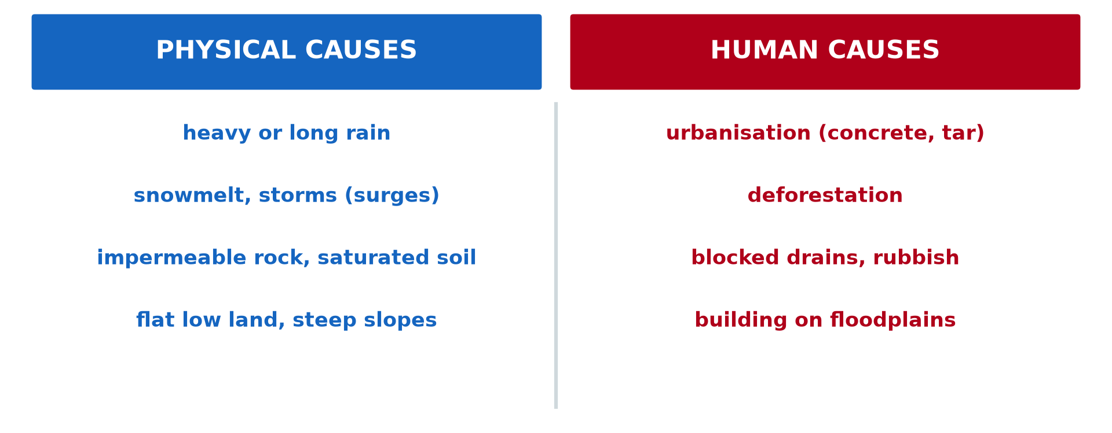
GEOGRAPHY — UPPER SIXTH ARTS
II. CAUSES
Activity 2
Physical and human causes.
2026 / 2027
DGCAST GAROUA — GEOGRAPHY DEPARTMENT
Mr KAMDEM E. | 17
Notes:
Without the projector: sort causes.

Slide 18
GEOGRAPHY — UPPER SIXTH ARTS
II. CAUSES
Activity 2: Question
Give two physical and two human causes of floods.
2026 / 2027
DGCAST GAROUA — GEOGRAPHY DEPARTMENT
Mr KAMDEM E. | 18

Slide 19
GEOGRAPHY — UPPER SIXTH ARTS
II. CAUSES
Answer
Physical: heavy rain, saturated soil. Human: urbanisation, blocked drains.
2026 / 2027
DGCAST GAROUA — GEOGRAPHY DEPARTMENT
Mr KAMDEM E. | 19

Slide 20
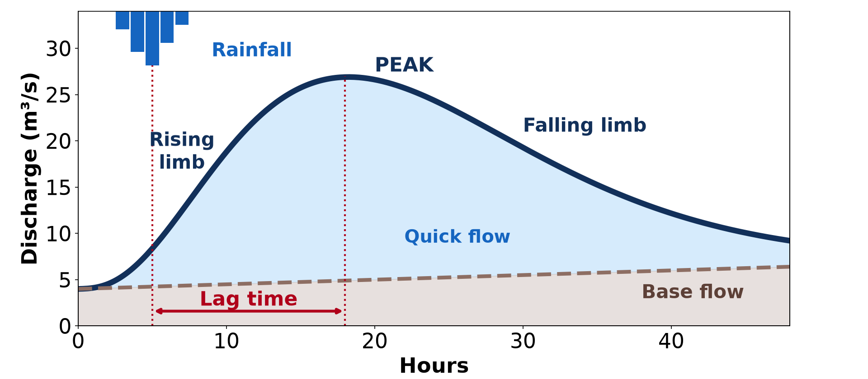
GEOGRAPHY — UPPER SIXTH ARTS
II. HYDROGRAPH
Activity 3
A storm hydrograph.
2026 / 2027
DGCAST GAROUA — GEOGRAPHY DEPARTMENT
Mr KAMDEM E. | 20
Notes:
Without the projector: read the lag time.

Slide 21
GEOGRAPHY — UPPER SIXTH ARTS
II. HYDROGRAPH
Activity 3: Question
Why do towns have shorter lag times?
2026 / 2027
DGCAST GAROUA — GEOGRAPHY DEPARTMENT
Mr KAMDEM E. | 21

Slide 22
GEOGRAPHY — UPPER SIXTH ARTS
II. HYDROGRAPH
Answer
Concrete and drains send water quickly to rivers.
2026 / 2027
DGCAST GAROUA — GEOGRAPHY DEPARTMENT
Mr KAMDEM E. | 22

Slide 23

GEOGRAPHY — UPPER SIXTH ARTS
III. EFFECTS
Activity 4
A flooded street.
2026 / 2027
DGCAST GAROUA — GEOGRAPHY DEPARTMENT
Mr KAMDEM E. | 23
Notes:
Without the projector: list effects.

Slide 24
GEOGRAPHY — UPPER SIXTH ARTS
III. EFFECTS
Activity 4: Question
Give three effects of floods.
2026 / 2027
DGCAST GAROUA — GEOGRAPHY DEPARTMENT
Mr KAMDEM E. | 24

Slide 25
GEOGRAPHY — UPPER SIXTH ARTS
III. EFFECTS
Answer
Loss of lives and houses, diseases and destroyed crops.
2026 / 2027
DGCAST GAROUA — GEOGRAPHY DEPARTMENT
Mr KAMDEM E. | 25

Slide 26
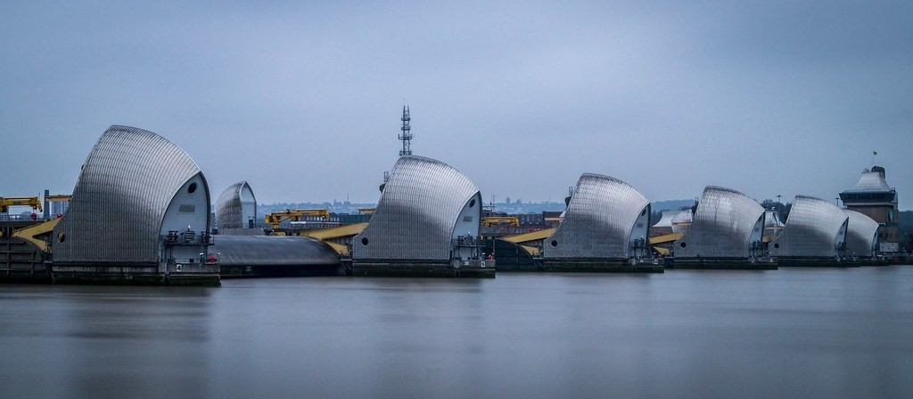
GEOGRAPHY — UPPER SIXTH ARTS
IV. MEASURES
Activity 5
The Thames Barrier, London.
2026 / 2027
DGCAST GAROUA — GEOGRAPHY DEPARTMENT
Mr KAMDEM E. | 26
Notes:
Without the projector: suggest measures for your town.

Slide 27
GEOGRAPHY — UPPER SIXTH ARTS
IV. MEASURES
Activity 5: Question
Give one hard and one soft engineering measure.
2026 / 2027
DGCAST GAROUA — GEOGRAPHY DEPARTMENT
Mr KAMDEM E. | 27

Slide 28
GEOGRAPHY — UPPER SIXTH ARTS
IV. MEASURES
Answer
Hard: barriers, levees or dams. Soft: land-use zoning or tree planting.
2026 / 2027
DGCAST GAROUA — GEOGRAPHY DEPARTMENT
Mr KAMDEM E. | 28

Slide 29
GEOGRAPHY — UPPER SIXTH ARTS
BOARD SUMMARY
Flooding
Topic: Contemporary Environmental Issues
Sub-topic: Climate Change
Lesson 6: Flooding
2026 / 2027
DGCAST GAROUA — GEOGRAPHY DEPARTMENT
Mr KAMDEM E. | 29
Notes:
Learners copy the board summary now. Give them enough time for each slide.

Slide 30
GEOGRAPHY — UPPER SIXTH ARTS
BOARD SUMMARY
I. Definitions
Flood: It is the covering of normally dry land by water.
Floodplain: It is the flat land beside a river that is flooded when the river overflows.
Lag time: It is the time between peak rainfall and peak river discharge.
2026 / 2027
DGCAST GAROUA — GEOGRAPHY DEPARTMENT
Mr KAMDEM E. | 30

Slide 31
GEOGRAPHY — UPPER SIXTH ARTS
BOARD SUMMARY
II. Causes and Effects (1/3)
A. Physical causes: Heavy or long rain, saturated soils and storm surges cause floods. Flat low land floods easily.
B. Human causes: Urbanisation, deforestation and blocked drains send water quickly to rivers. Building on floodplains puts people at risk.
2026 / 2027
DGCAST GAROUA — GEOGRAPHY DEPARTMENT
Mr KAMDEM E. | 31

Slide 32
GEOGRAPHY — UPPER SIXTH ARTS
BOARD SUMMARY
II. Causes and Effects (2/3)
C. Effects: Floods kill people, destroy houses, roads and crops and spread diseases. They can also bring fertile silt.
2026 / 2027
DGCAST GAROUA — GEOGRAPHY DEPARTMENT
Mr KAMDEM E. | 32

Slide 33
GEOGRAPHY — UPPER SIXTH ARTS
BOARD SUMMARY
II. Causes and Effects (3/3)
Copy the hydrograph.
2026 / 2027
DGCAST GAROUA — GEOGRAPHY DEPARTMENT
Mr KAMDEM E. | 33

Slide 34
GEOGRAPHY — UPPER SIXTH ARTS
BOARD SUMMARY
III. Measures
A. Hard engineering: Dams, levees, barriers and wider channels hold back water. They are costly but protect towns.
B. Soft engineering: Land-use zoning, tree planting and warnings reduce risk. Clean drains are cheap and effective.
2026 / 2027
DGCAST GAROUA — GEOGRAPHY DEPARTMENT
Mr KAMDEM E. | 34

Slide 35
GEOGRAPHY — UPPER SIXTH ARTS
FORMATIVE EVALUATION
Formative Evaluation 1
Give two causes of urban floods.
2026 / 2027
DGCAST GAROUA — GEOGRAPHY DEPARTMENT
Mr KAMDEM E. | 35

Slide 36
GEOGRAPHY — UPPER SIXTH ARTS
FORMATIVE EVALUATION
Expected Answer
Concrete surfaces and blocked drains.
2026 / 2027
DGCAST GAROUA — GEOGRAPHY DEPARTMENT
Mr KAMDEM E. | 36

Slide 37
GEOGRAPHY — UPPER SIXTH ARTS
FORMATIVE EVALUATION
Formative Evaluation 2
Compare hard and soft engineering.
2026 / 2027
DGCAST GAROUA — GEOGRAPHY DEPARTMENT
Mr KAMDEM E. | 37

Slide 38
GEOGRAPHY — UPPER SIXTH ARTS
FORMATIVE EVALUATION
Expected Answer
Hard: costly structures. Soft: cheaper natural methods and planning.
2026 / 2027
DGCAST GAROUA — GEOGRAPHY DEPARTMENT
Mr KAMDEM E. | 38

Slide 39
GEOGRAPHY — UPPER SIXTH ARTS
REMEDIATION
Remediation
Fill in the blanks:
Flat land beside a river is a ______.
Walls built along rivers are ______.
Planning where to build is land-use ______.
2026 / 2027
DGCAST GAROUA — GEOGRAPHY DEPARTMENT
Mr KAMDEM E. | 39
Notes:
Answers: 1. floodplain 2. levees 3. zoning

Slide 40
GEOGRAPHY — UPPER SIXTH ARTS
HOMEWORK
Homework
Map the flood-prone areas of your town and suggest two solutions.
This prepares Lesson 7: Notion of Development.
2026 / 2027
DGCAST GAROUA — GEOGRAPHY DEPARTMENT
Mr KAMDEM E. | 40
Notes:
This homework prepares the next lesson.

Slide 41
GEOGRAPHY — UPPER SIXTH ARTS
BILINGUAL GAME
Bilingual Game (Jeu Bilingue)
English | Français
Flood | L'inondation
Drain | Le caniveau
Dam | Le barrage
Levee | La digue
Warning | L'alerte
Floodplain | La plaine d'inondation
2026 / 2027
DGCAST GAROUA — GEOGRAPHY DEPARTMENT
Mr KAMDEM E. | 41
Notes:
Say the English word; learners give the French word, then the reverse.

Slide 42
GEOGRAPHY — UPPER SIXTH ARTS
LOGBOOK
Official Logbook (1/2)
Module / Topic | Contemporary Environmental Issues
Lesson Title | Lesson 6: Flooding
Expected Learning Outcomes | Define flooding and describe its magnitude. Explain the causes and effects of floods. Propose measures to reduce flood damage.
Competence | Learners are able to explain the causes and effects of floods and propose measures.
2026 / 2027
DGCAST GAROUA — GEOGRAPHY DEPARTMENT
Mr KAMDEM E. | 42

Slide 43
GEOGRAPHY — UPPER SIXTH ARTS
LOGBOOK
Official Logbook (2/2)
Matter Taught | I. Definitions: Flood, Floodplain, Lag time; II. Causes and Effects: Physical causes, Human causes, Effects; III. Measures: Hard engineering, Soft engineering.
Evaluation | Formative evaluation (3 questions) and remediation exercise.
Homework | Map the flood-prone areas of your town and suggest two solutions.
Enrolment / Present / Absent | ____ / ____ / ____
Achievement | To be completed by the teacher after the lesson.
2026 / 2027
DGCAST GAROUA — GEOGRAPHY DEPARTMENT
Mr KAMDEM E. | 43

Slide 44
GEOGRAPHY — UPPER SIXTH ARTS
TEACHER'S NOTE
Teacher's Note
Timing: Set-up, recall 8 min | Situation 8 min | 5 activities 30 min | Board summary (copying) 30 min | Evaluation, remediation 10 min | Homework, logbook 9 min | Spare 5 min
2026 / 2027
DGCAST GAROUA — GEOGRAPHY DEPARTMENT
Mr KAMDEM E. | 44

Slide 45
GEOGRAPHY — UPPER SIXTH ARTS
REFERENCES
References
National Geography Syllabus, Sixth Forms (Lower & Upper Sixth), MINESEC/IGE/IP-SS, August 2019 — Module 7 (Environment and Development).
Photo, Activity 1: “Flood in Accra” by Stig Nygaard, CC BY 2.0, via Flickr (https://www.flickr.com/photos/10259776@N00/181742000)
Photo, Activity 4: “Vicenza flooding Nov.1, 2010” by US Army Africa, CC BY 2.0, via Flickr (https://www.flickr.com/photos/36281822@N08/5157191333)
Photo, Activity 5: “Thames Barrier” by dolbinator1000, CC BY 2.0, via Flickr (https://www.flickr.com/photos/126654539@N08/32983498011)
Diagrams and animations: drawn for this lesson (DGCAST Geography Department).
2026 / 2027
DGCAST GAROUA — GEOGRAPHY DEPARTMENT
Mr KAMDEM E. | 45

